Slide 1
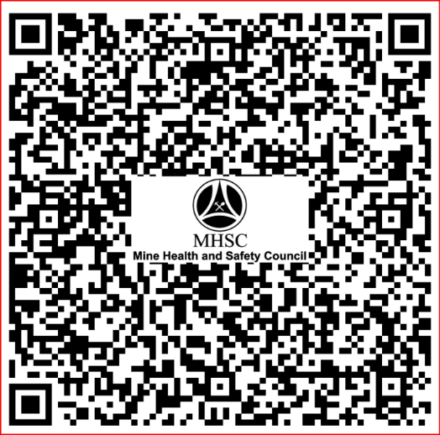
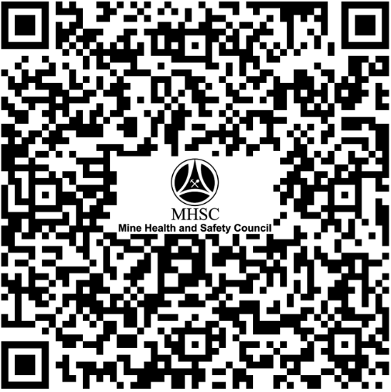
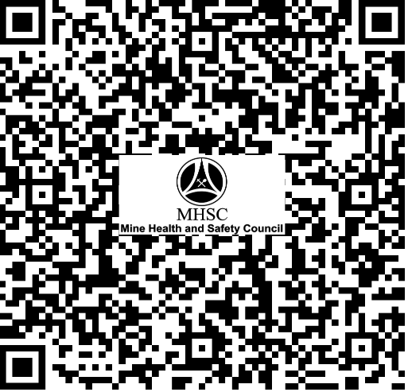
NEW GUIDANCE NOTE:
NON-COMMUNICABLE DISEASES
AND MENTAL HEALTH DISORDERS
REVISED REGULATION 22.9 (2) (a):
OCCUPATIONS EXPOSURE LIMITS
FOR AIRBORNE POLLUTANTS
REVISED CHAPTER 16:
RESCUE, FIRST AID AND EMERGENCY
PREPAREDNESS AND RESPONSE

